Slide 1
Weekly Warm Ups to Engage Students
Ashley Taplin (atapli@neisd.net)
Npreas
Special thanks to http://mathequalslove.blogspot.com/ and #MTBOS for inspiring this in our classrooms

Slide 2
Mental Math Monday
Using the template that we gave you, in the Monday section simply write down the final answer you get.
Example 1: We will call out a series of mathematical operations. Your job is to follow the steps in your head until we ask you to record your final answer.
Example 2: We will draw an “I chart” or “X factor” and your job is to fill in the missing values to complete the puzzle.
https://mrstaplinsmath.wordpress.com/2015/10/26/mental-math-monday/

Slide 3
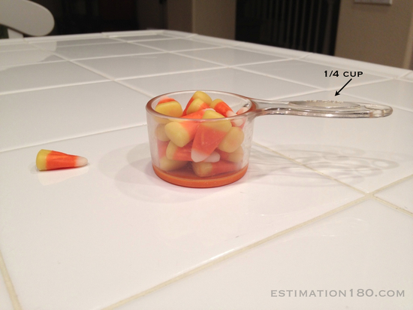
Think It Through Tuesday
In the Tuesday section estimate the amount of candy corn there are in a ¼ cup.

Slide 4
Think It Through Tuesday
Open up a document that you use for warm ups (Smart file, power point, google slide, …)
Go to the website estimation180.com and find an estimation problem you would like to have your kids try the first week of warm ups.
Use the screen capture feature in smart or the snip it tool to embed the picture in your warm up.
Have website open on your computer to share the answer with your class after you have received their estimations.

Slide 5
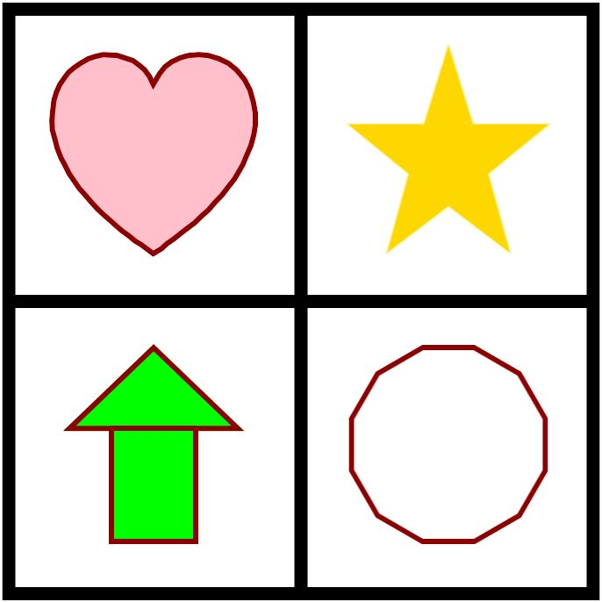
Which One Doesn’t Belong Wednesday
Determine which shape you feel doesn’t belong and explain why using complete sentences.

Slide 6
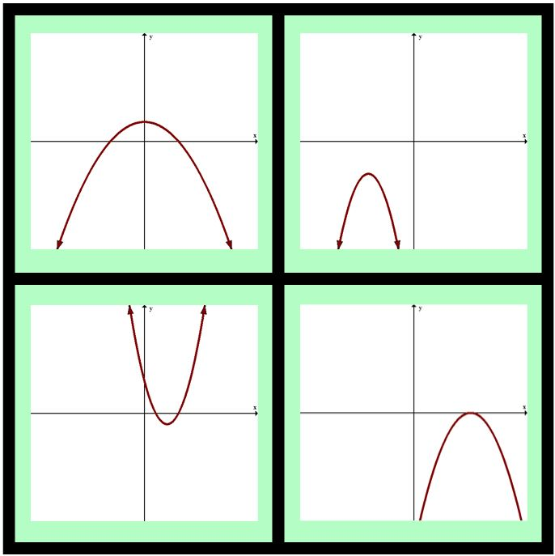
Which One Doesn’t Belong Wednesday
Determine which graph you feel doesn’t belong and explain why using complete sentences.

Slide 7
Which one doesn’t belong wednesday
Open up a document that you use for warm ups (Smart file, power point, google slide, …)
Go to the website wodb.ca and find an image you would like to have your kids try the first week of warm ups.
Use the screen capture feature in smart or the snip it tool to embed the picture in your warm up.

Slide 8
Throwback Thursday
There are several options you can do for this day. Some are listed below:
    Spiraling topics (consider using STAAR, PSAT, SAT, TSI as well)
    Writing prompt supporting SEL concepts as a check in with students
      Ex. “tell me what you learned this week” or “what is something you’re proud of?”
      These can be math related or not, to give you more insight into your students
I liked to collect these on a notecard/half sheet of paper to sort into 3 levels of readiness piles for spiraled topics or to learn more about my students when using it as SEL.

Slide 9
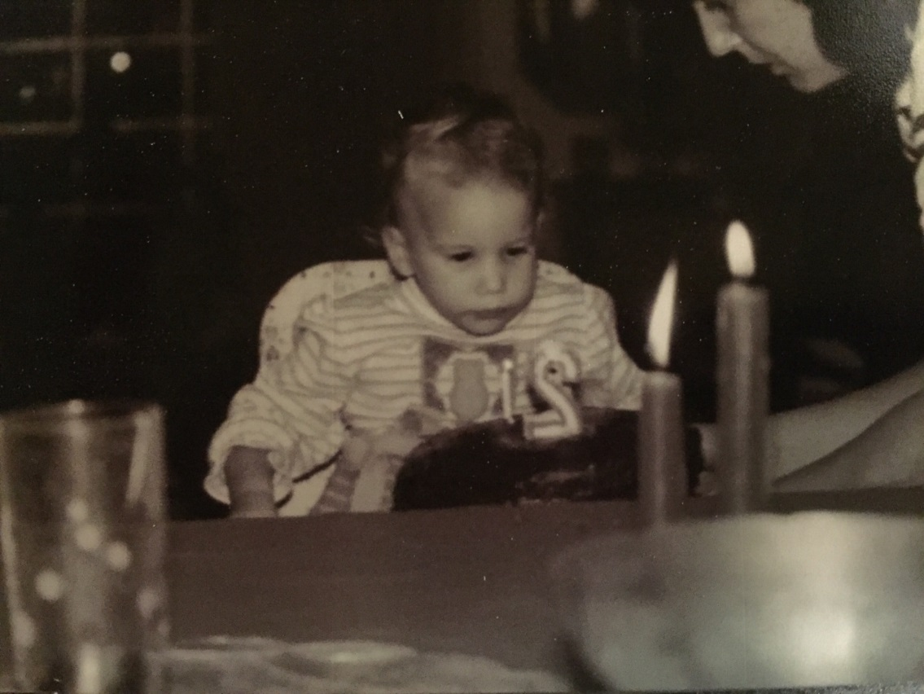
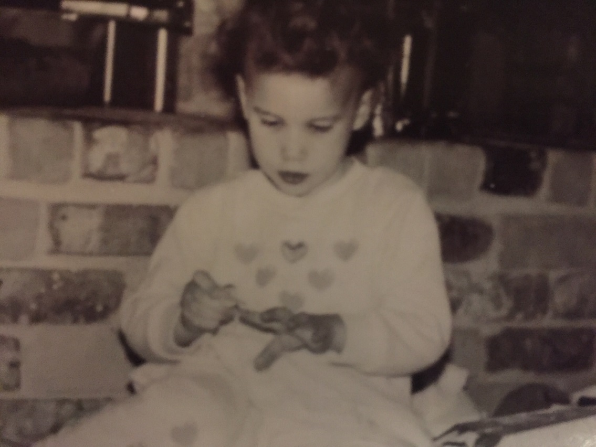
Can you guess whose throwback pictures these are???

Slide 10
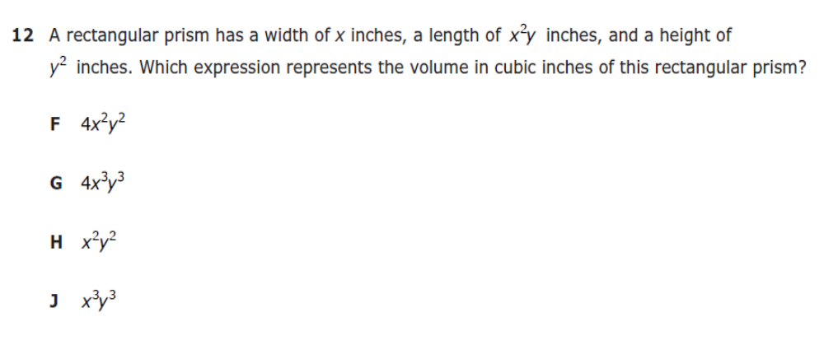
Favorite No Friday
A most missed question on last year’s released Algebra STAAR test is below. The most chosen answer was H. Determine the correct answer to the question and predict why students thought it was H.
Use the stem: The answer is ______ because ______. I think students chose H because ______.

Slide 11
Take some time to try to finish your warm ups to use for a week.
If you would like a copy of the warm up template given to you, the full page theme days to hang in your classroom, or any of the warm ups we have already created please let us know and we can share them with you.
**All materials presented can be found in the google folder that was shared with you today.

